Slide 1



Hardware Insights
Consumer Goods
#codebasicsresumeprojectchallenge
Made By : Siddhi Joshi

Slide 2

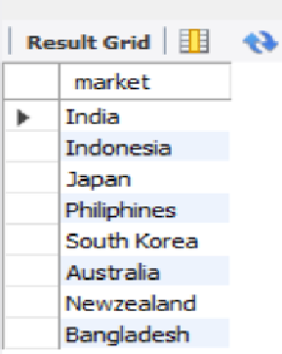
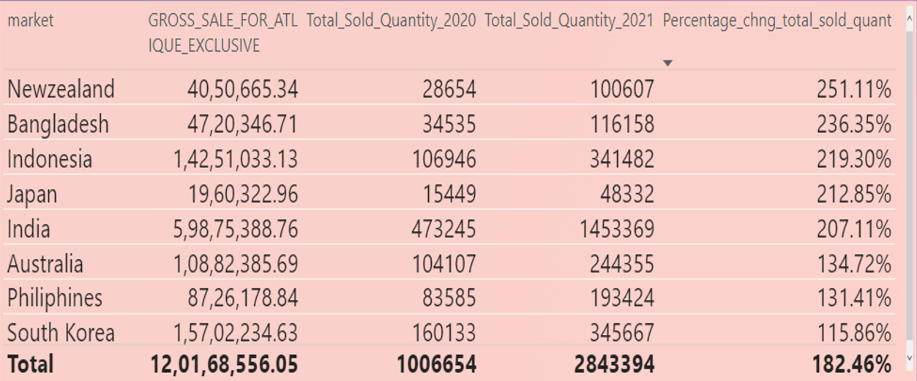
Question 1.
Provide the list of markets in which customer "Atliq Exclusive" operates its business in the APAC region.
Atliq Exclusive operates its business in the APAC region in these following countries.
India has the maximum Gross_sales.
However, the demand is growing the maximum in NewZealand by almost 251.11%

Slide 3

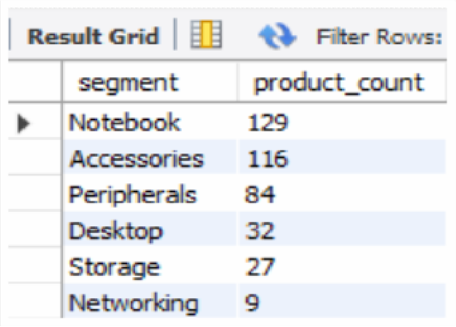
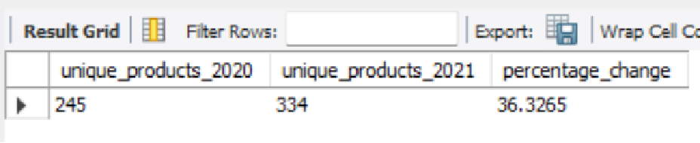
Question 2.
What is the percentage of unique product increase in 2021 vs. 2020?
The final output contains these fields, ◉ unique_products_2020 ◉ unique_products_2021 ◉ percentage_chg
Report of all the unique product counts for each segment
percentage of unique product increase in 2021 vs. 2020

Slide 4
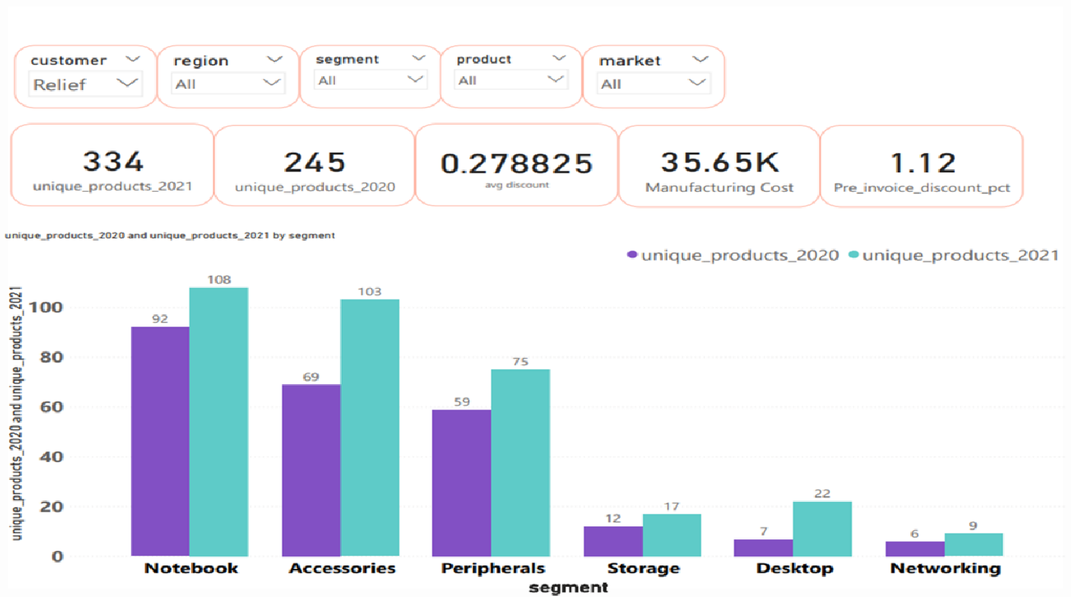
Question 3.
Provide a report with all the unique product counts for each segment and sort them in descending order of product counts.
The final output contains 2 fields, ◉ segment ◉ product_count

Slide 5

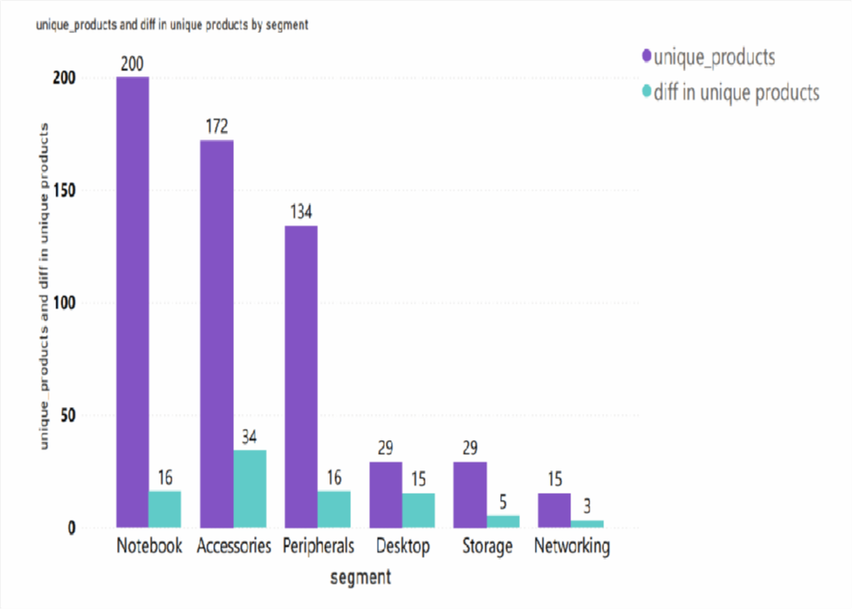
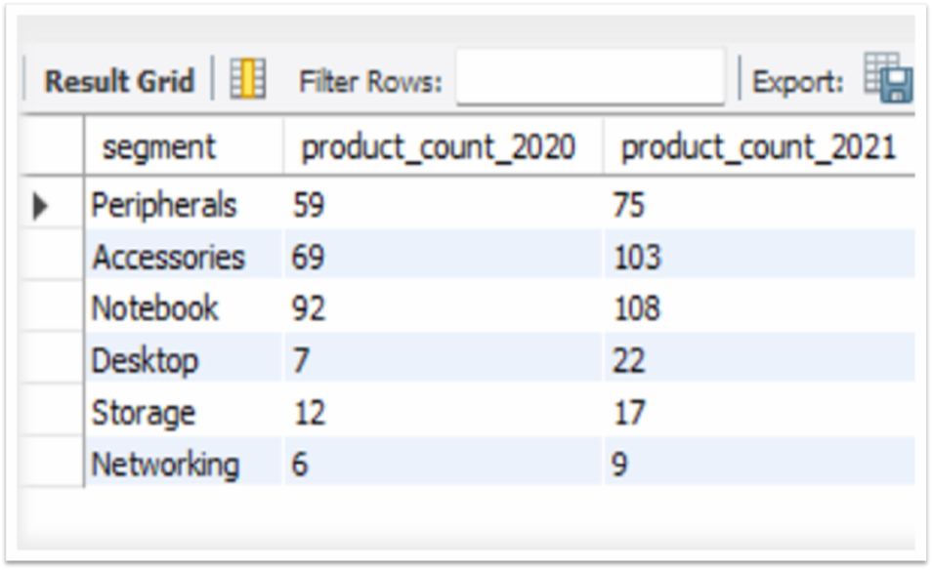
Question 4.
Follow-up: Which segment had the most increase in unique products in 2021 vs 2020?
The final output contains these fields,◉ segment ◉ product_count_2020 ◉ product_count_2021 ◉ difference
Accessories had the most increase in unique products from 2020 to 2021
Segment’s product count increase from 2020 to 2021

Slide 6
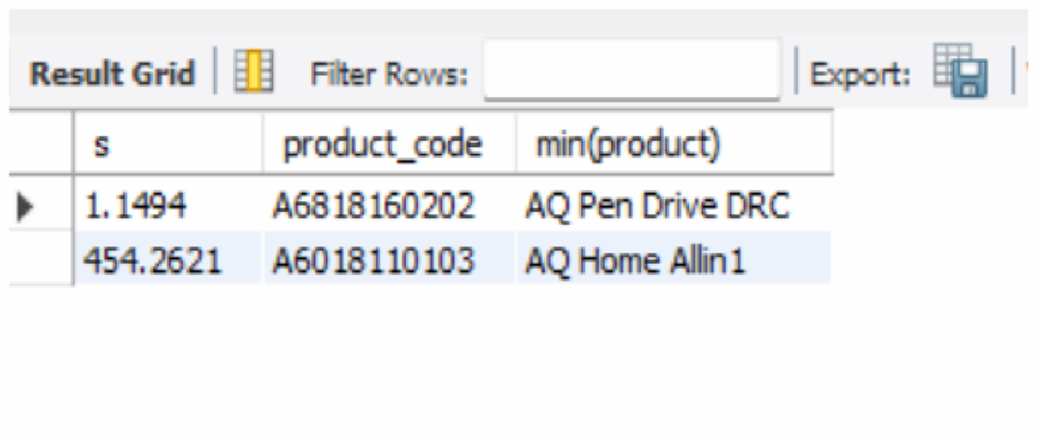


Question 5.
Get the products that have the highest and lowest manufacturing costs.
The final output should contain these fields, ◉ product_code ◉ product ◉ manufacturing_cost
Products that have the highest and lowest manufacturing costs.

Slide 7
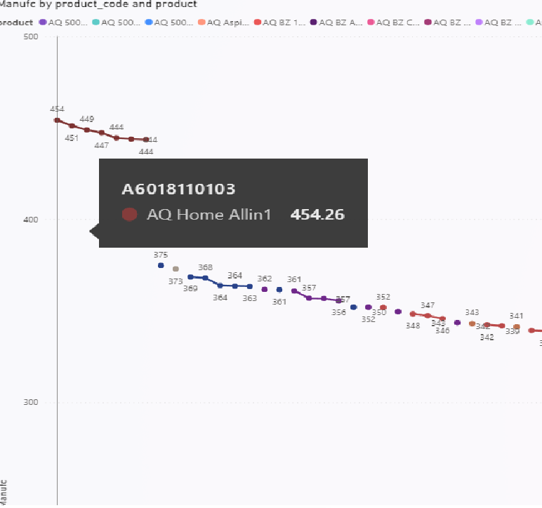
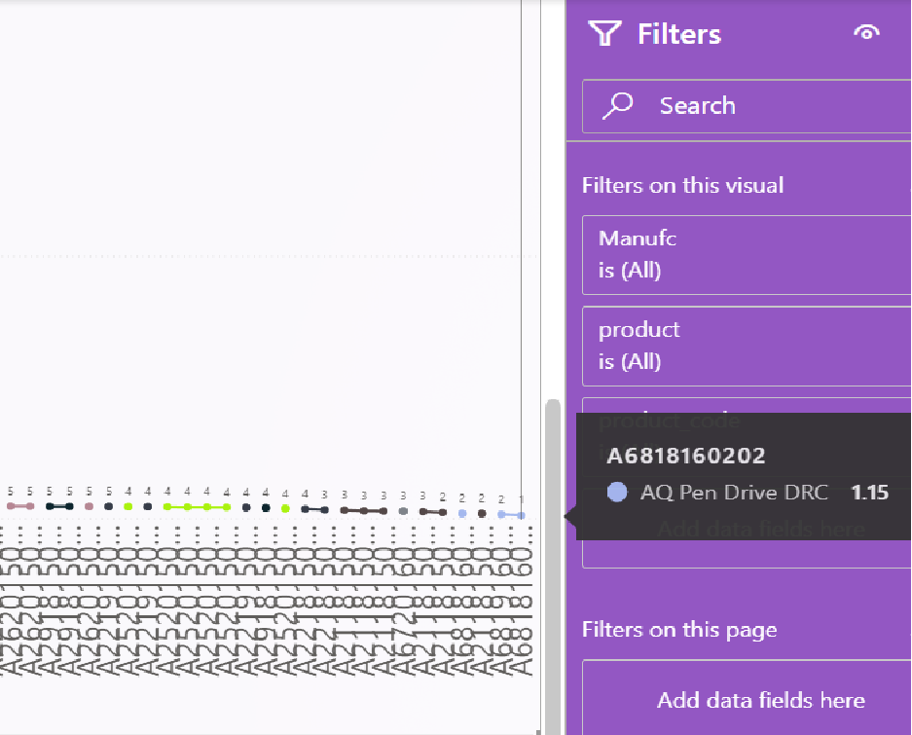
Question 5. (Contd.)

Slide 8
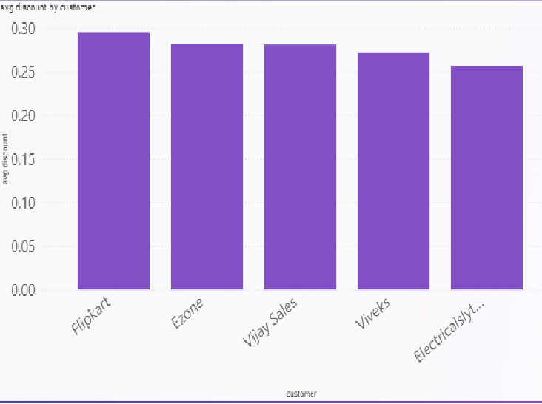
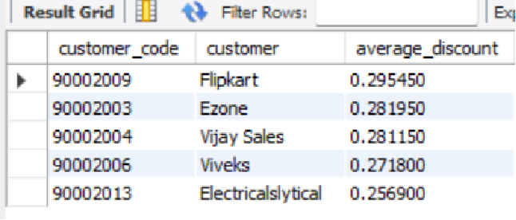
Question 6.
Generate a report which contains the top 5 customers who received an average high pre_invoice_discount_pct for the fiscal year 2021 and in the Indian market.
The final output contains these fields, ◉ customer_code ◉ customer ◉ average_discount_percentage
Top 5 customers who received an average high pre_invoice_discount_pct for the fiscal year 2021 and in the Indian market.
It can be seen that Flipkart receives the highest pre invoice discount in 2021 in the Indian Market

Slide 9
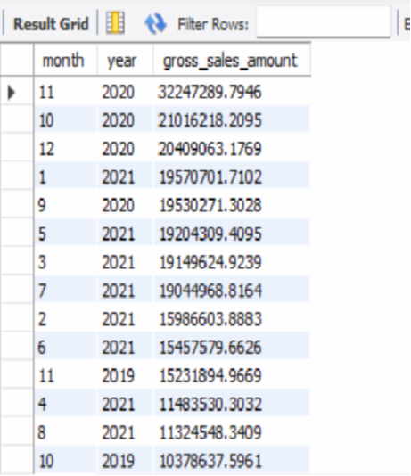
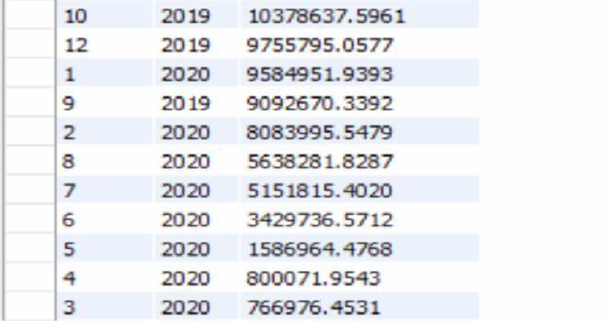

Question 7.
Get the complete report of the Gross sales amount for the customer “Atliq Exclusive” for each month. This analysis helps to get an idea of low and high-performing months and take strategic decisions.
The final report contains these columns: ◉ Month ◉ Year ◉ Gross sales Amount
Report of the Gross sales amount for the customer “Atliq Exclusive” for each month.
Through the reports, it can be seen that in 2020, November had the highest gross_sale and March had the lowest.
Whereas in 2021, January had the highest sales and August had the lowest sales.

Slide 10
Question 7.
Get the complete report of the Gross sales amount for the customer “Atliq Exclusive” for each month. This analysis helps to get an idea of low and high-performing months and take strategic decisions.
The final report contains these columns: ◉ Month ◉ Year ◉ Gross sales Amount
Report of the Gross sales amount for the customer “Atliq Exclusive” for each month.
Through the reports, it can be seen that in 2020, November had the highest gross_sale and March had the lowest.
Whereas in 2021, January had the highest sales and August had the lowest sales.

Slide 11
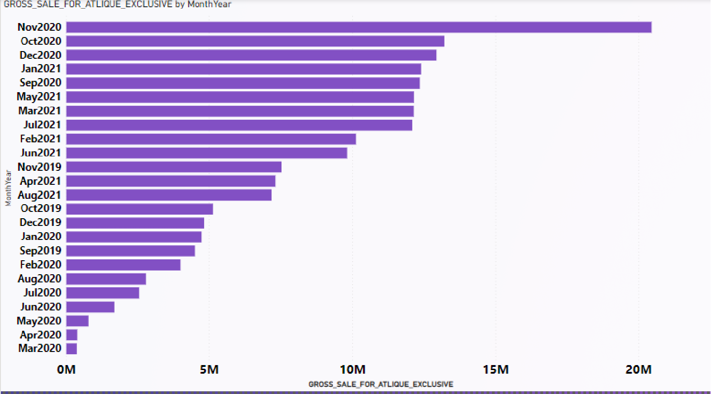

Question 7. (Contd.)

Slide 12
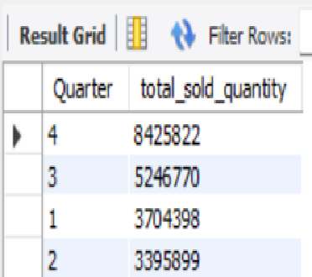
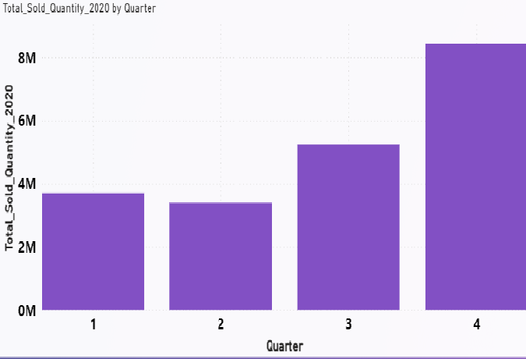
Question 8.
In which quarter of 2020, got the maximum total_sold_quantity?
The final output contains these fields sorted by the total_sold_quantity, ◉ Quarter ◉ total_sold_quantity
In 2020, 4th quarter got the maximum total_sold_quantity.

Slide 13
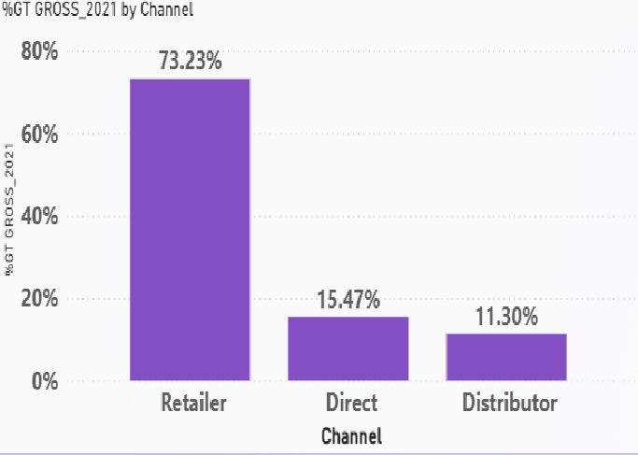
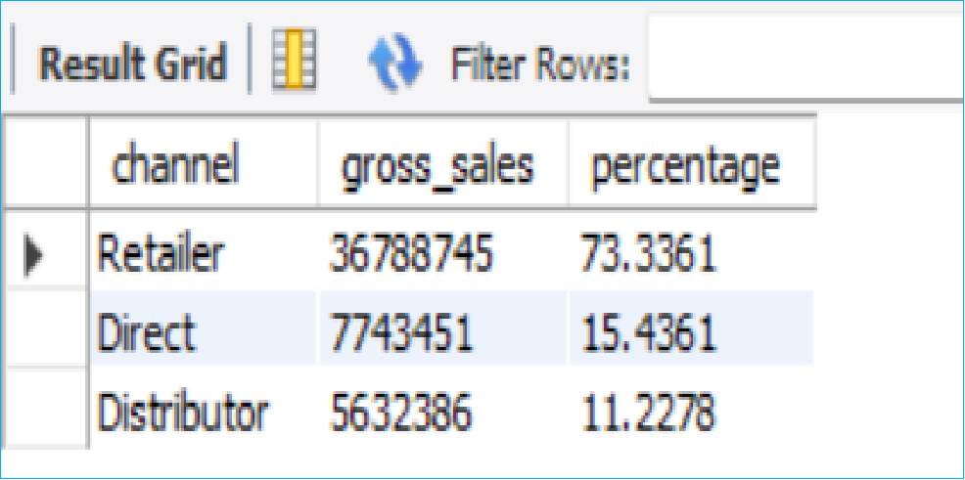
Question 9.
Which channel helped to bring more gross sales in the fiscal year 2021 and the percentage of contribution?
The final output contains these fields, ◉ channel ◉ gross_sales_mln ◉ percentage
The Retailer Channel helped in in bringing the maximum gross sale in the year 2021

Slide 14
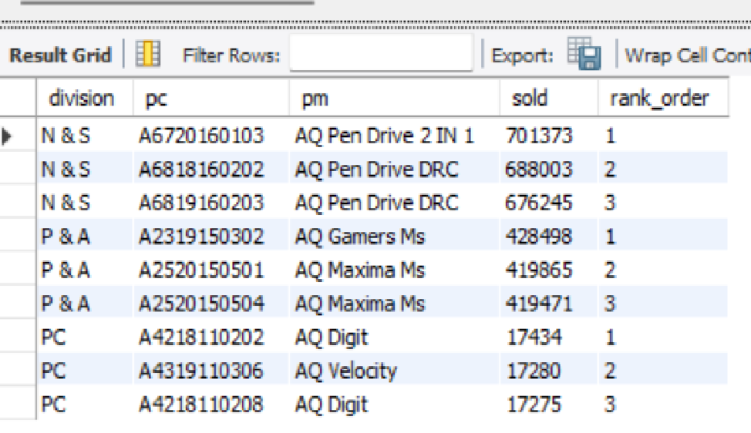
Question 10.
Get the Top 3 products in each division that have a high total_sold_quantity in the fiscal_year 2021?
The final output contains these fields, ◉ division ◉ product_code
Top 3 products in each division that have a high total_sold_quantity in the fiscal_year 2021.

Slide 15


Thank you!
I would like to extend my warm regards to the entire team of codebasics, especially Mr. Dhawal Patel for giving their valuable assistance and tutorials which led to the completion of the project.

